Slide 1
Installation Guide
(Web Server – WebtoB 4.1
- Filter)
2009. 07. 24
CODELABOR
Shin Sang Jae (codelabor@gmail.com)

Slide 2
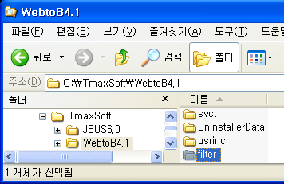
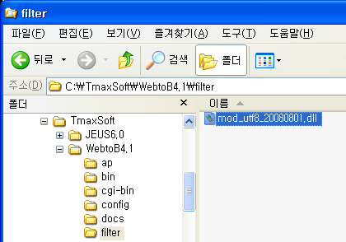

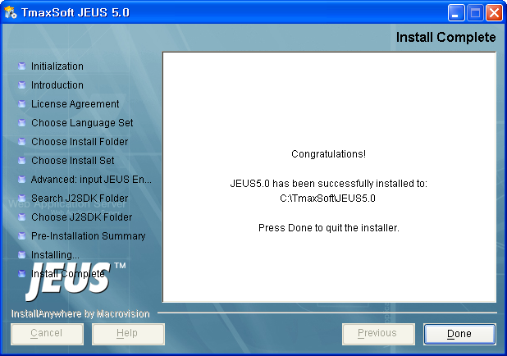
WebtoB
Install
Make Directory
  Directory: C:\TmaxSoft\WebtoB4.1\filter
Copy File
  File: mod_utf8_20080801.dll

